Slide 1





SPM Final Presentation
Notes:
tricia

Slide 2
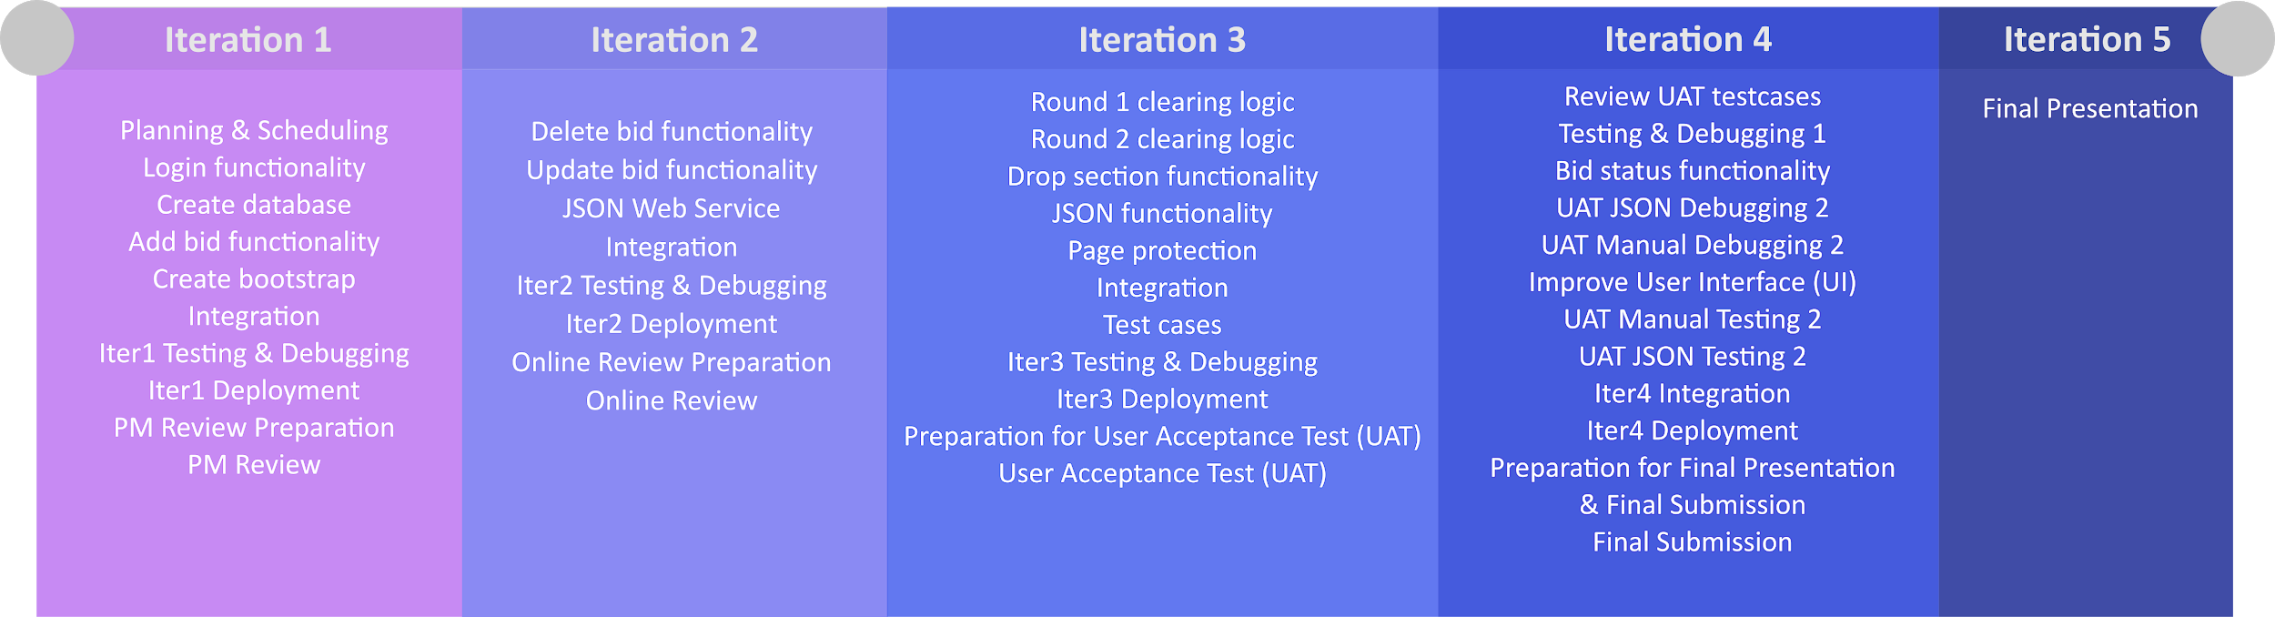
Timeline (Planned)
Notes:
Tricia
Delete bid functionality from Iter 2 to Iter1
Add bid validation from Iter1 to Iter2
Round 1 clearing logic from Iter3 to Iter2

Slide 3
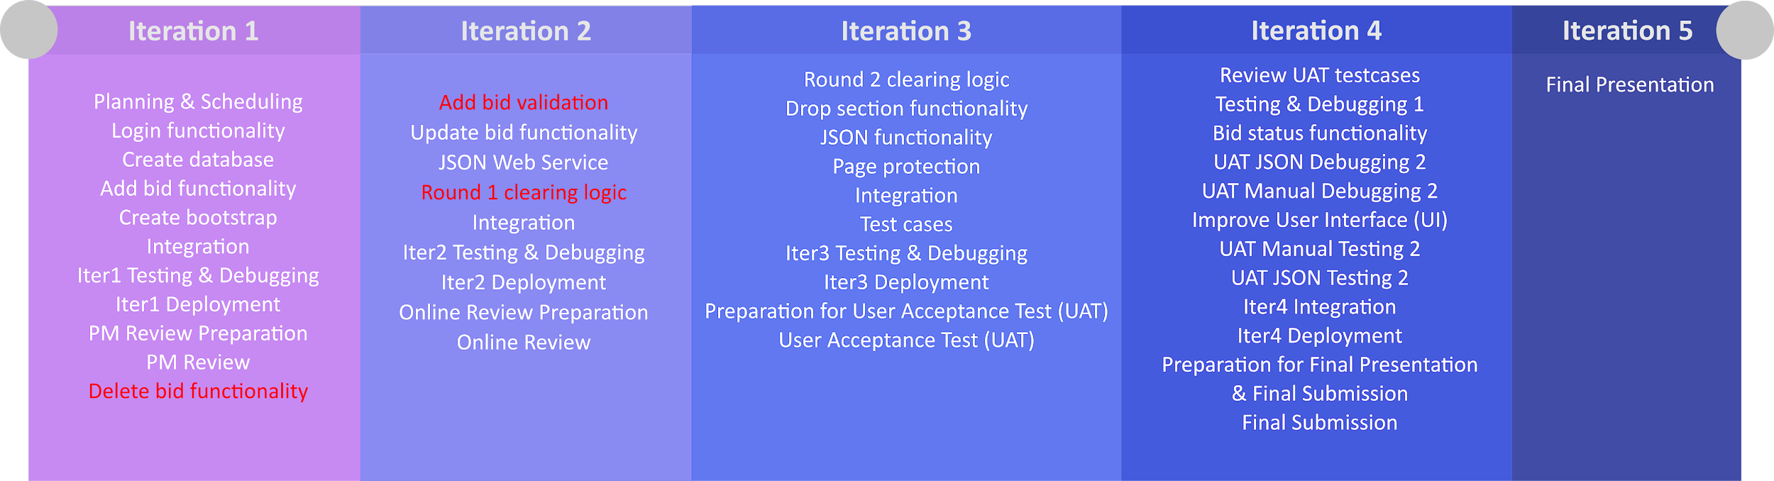
Timeline (Actual)
Notes:
tricia

Slide 4
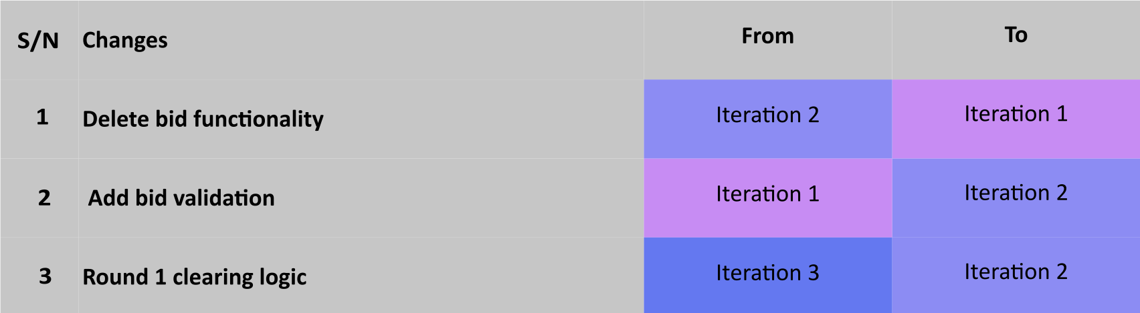
Main Differences in schedule
Notes:
Tricia
Broke down parts of functionalities to be in two different iterations → flexibility in not conforming one functionality to be completed within one iteration independently as we realise interconnections between functionalities eg. bootstrap & Round Clearing
Otherwise, stuck to timeline well :)

Slide 5
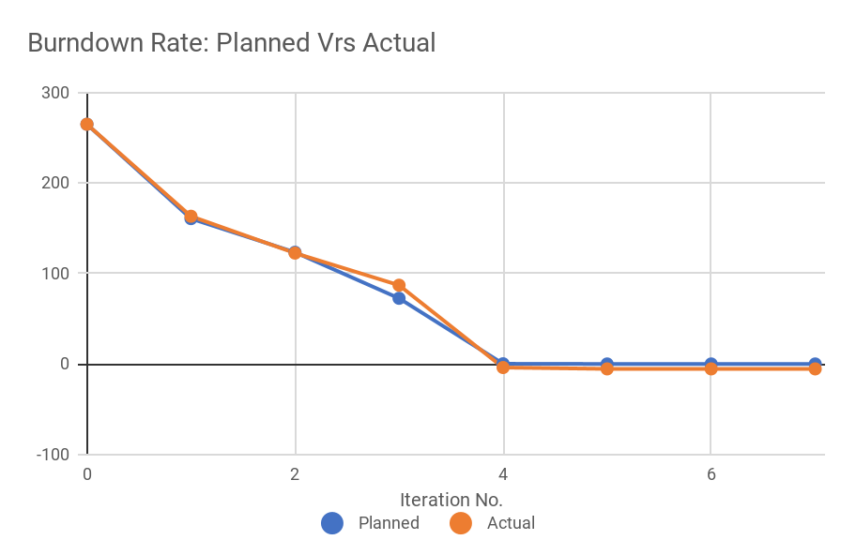
Actual VS Planned Schedule
Notes:
tricia

Slide 6
Functionalities
Wiki Questions | Answers
Drop any functionalities? | No
Add any functionalities? | No
Any frameworks/external libraries? | No
Notes:
tricia

Slide 7
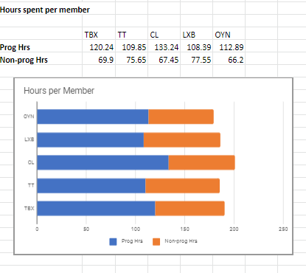
Task Allocation Breakdown - Programming
Member | Hours spent | %
TBX | 120.24 | 20.5
TT | 109.85 | 18.7
CL | 133.24 | 22.8
LXB | 108.39 | 18.5
OYN | 112.89 | 19.3
Notes:
Casper

Slide 8
Task Allocation Breakdown - Programming
Total time | 584.61 hours
Average time per person | 116.922 hours
Below Average | TT, LXB, OYN
Above average | TBX, CL
Notes:
Casper

Slide 9
Task Allocation Breakdown - Programming
Member | Hours spent | % | Functionalities
TBX | 120.24 | 20.5 | Bootstrap Validation, Add bid, Json Web services, Drop Section, Bid Status, Round
TT | 109.85 | 18.7 | Add bid, Update Bid, Login, Add bid validation, Round
CL | 133.24 | 22.8 | Bootstrap Validation, Delete Bid, Login, Json Web services, Drop Section, Bid Status, Add bid validation
LXB | 108.39 | 18.5 | Bootstrap, Delete Bid, UI, Protect
OYN | 112.89 | 19.3 | Bootstrap, Update Bid, UI, Protect
Notes:
casper

Slide 10
Task Allocation Breakdown -
Non - Programming
Member | Hours spent | % | Tasks
TBX | 69.9 | 19.6 | Presentation Slides, Meeting Minutes, Bug Metric, Daily Updates, Scheduling, Testing, Knowledge sharing, Design, Planning
TT | 75.65 | 21.2
CL | 67.45 | 18.9
LXB | 77.55 | 21.8
OYN | 66.2 | 18.5
Notes:
casper

Slide 11
Problems tracking schedule
Many different attributes under task type but not intuitive to categorize
Time factor in hours → inaccuracy
Optimistic project plan → unable to complete certain tasks as planned
Notes:
Baoxian: Tell us about the problems you faced tracking your schedule and how you overcame them

Slide 12
Overcoming challenges in tracking schedule
Ensures consistency across iterations,
Refers to previous PM
Constantly checks wiki and updating formatting
Call a short meeting and get the team together to explain the situation and schedule next iteration with realistic estimates
Notes:
Baoxian: Tell us about the problems you faced tracking your schedule and how you overcame them

Slide 13
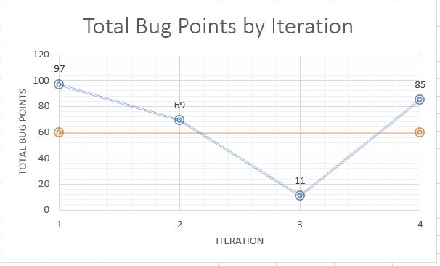
Bug Metric
Notes:
YanNing <insert a graph of metric over time, perhaps at each iteration and its halfway mark>

Slide 14
Using the Bug Metric
Identifying Bottlenecks
Bootstrap -> Round clearing
Web UI-> Json Web Service
Scheduling debugging sessions
“Bug squashing day” each iteration
More debugging at iteration 4 (After UAT)
Total bug points in iteration >= 10 (Stop current development and resolve bugs immediately)
Notes:
YanNing

Slide 15
Follow-on Actions
Communicated severe problems identified by bug metrics
Scheduled team meeting
Discussed bug issues and debug
Checked schedule to plan subsequent tasks accordingly
Execute subsequent tasks

Slide 16
Challenges faced when using bug metric
Difficulty collecting bug metrics
Most bugs were found while programming and were solved immediately
Unable to quickly determine source of bug
Overcoming Challenges
Use GIT to track where bug was introduced
Conscious effort to update bug metrics
Notes:
YanNing

Slide 17
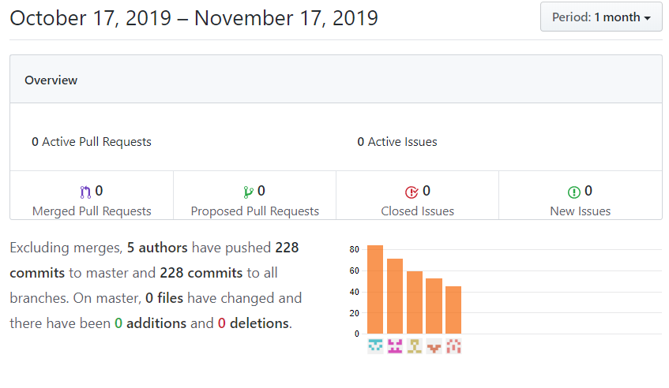
Git Usage
Notes:
yanning

Slide 18
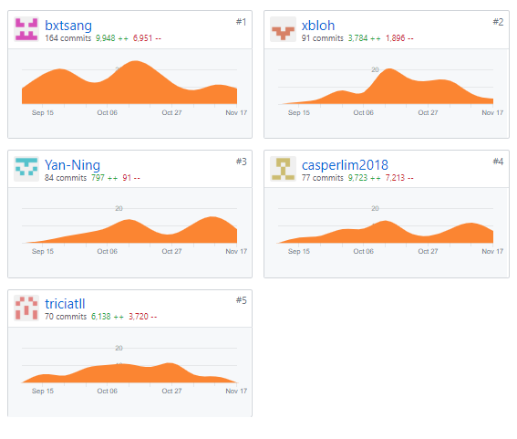
Git Usage
Notes:
yanning

Slide 19


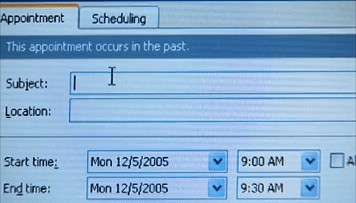

Some takeaways
Importance of scheduling
Importance of regression testing
Working as a team
Notes:
celine

Slide 20
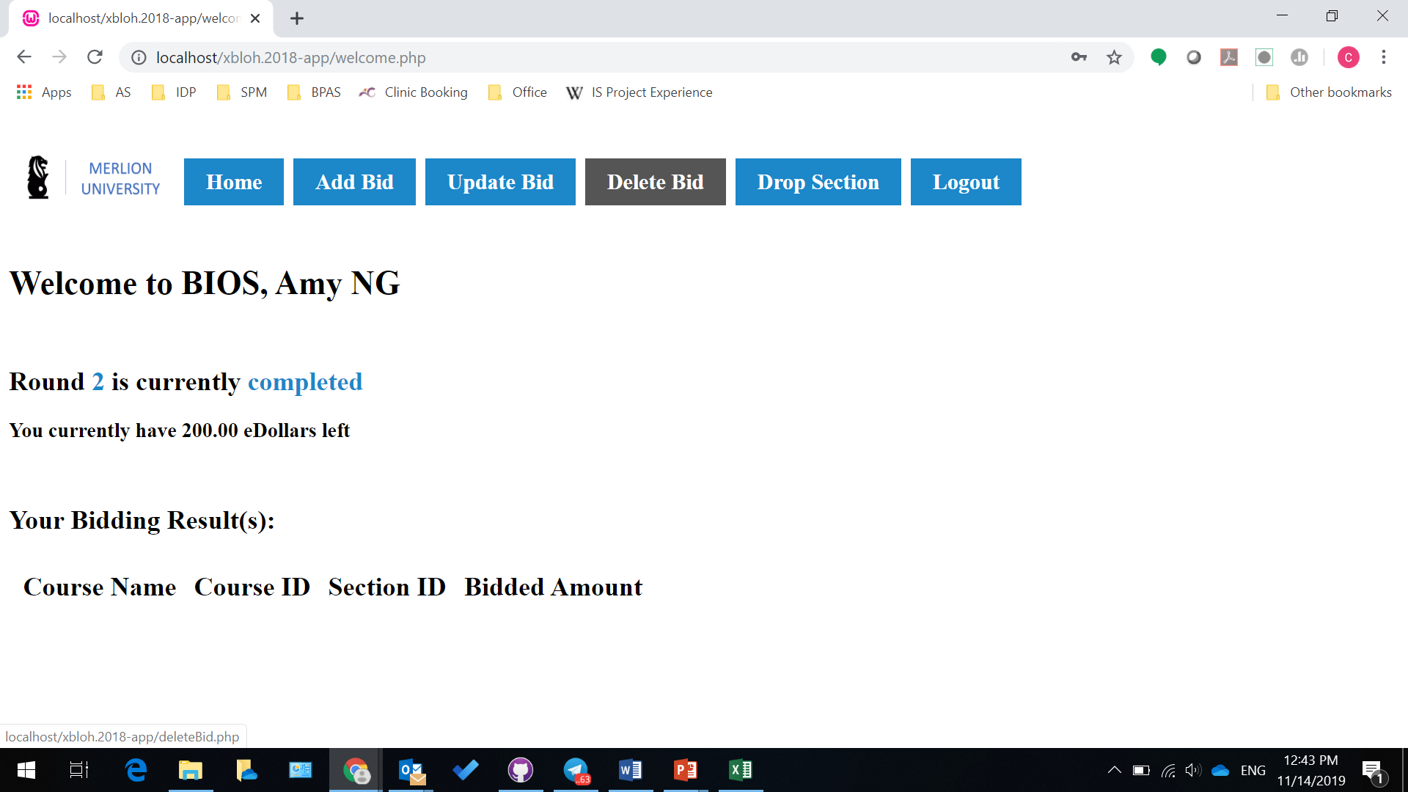
Main Takeaway
Place your screenshot here
Taking something from start to end
Working in pairs
BIOS
Student User Page
Notes:
Celine Code from scratch

Slide 21
How we rolled
Conflict | Root Cause | Resolution
Not enough time for testing and debugging | Too much time spent on coding | Schedule buffer time, effective task allocation
Not always full attendance during meetings | Many concurrent projects | Effective task allocation, team accountability
Notes:
celine

Slide 22

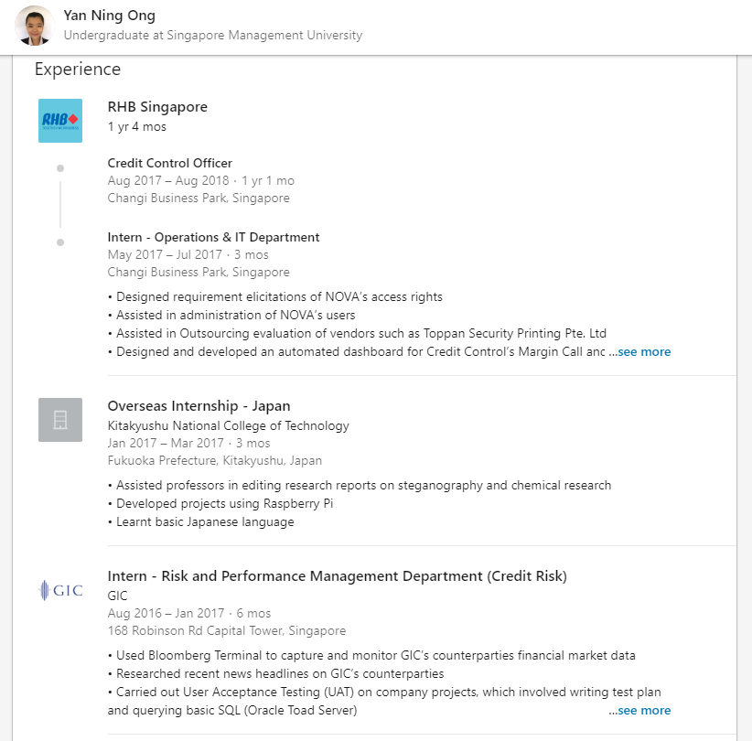


Fun Facts about us
Notes:
celine

Slide 23

Fun Facts about us
We have the same preference for music genre
Chinese pop songs
Notes:
celine

Slide 24
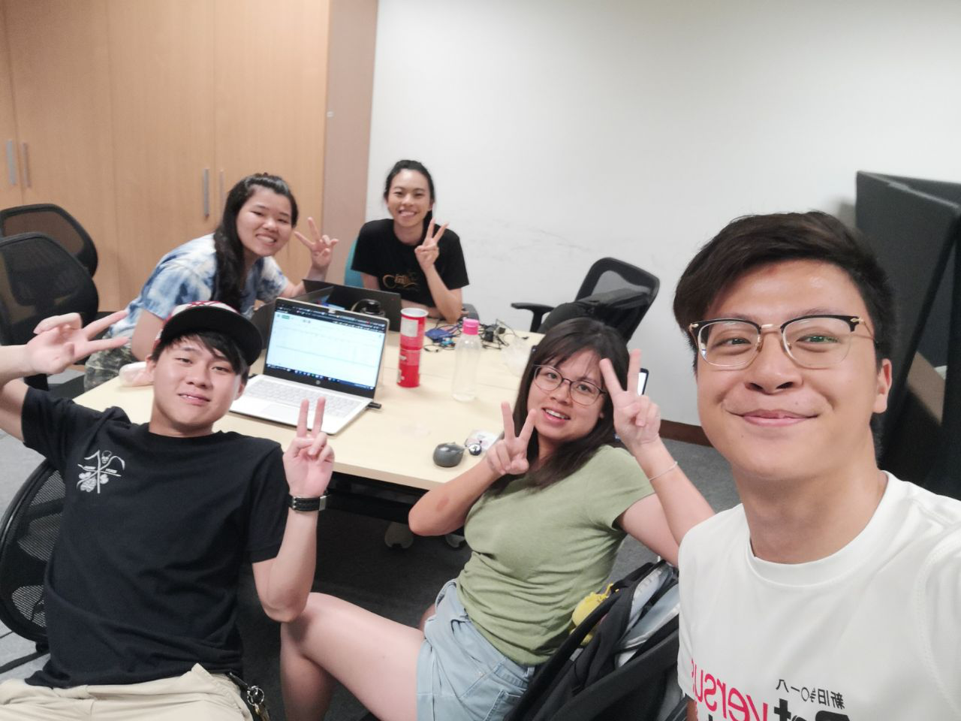

Our home - SIS Project Way
our first home
Notes:
celine

Slide 25


Thanks!
😉
We had fun!
Notes:
celine

